Slide 1

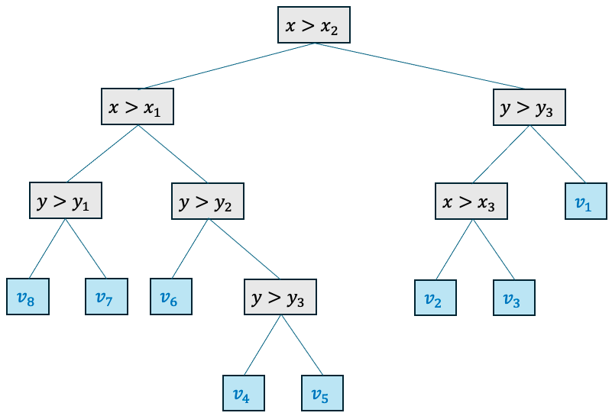

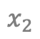
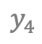
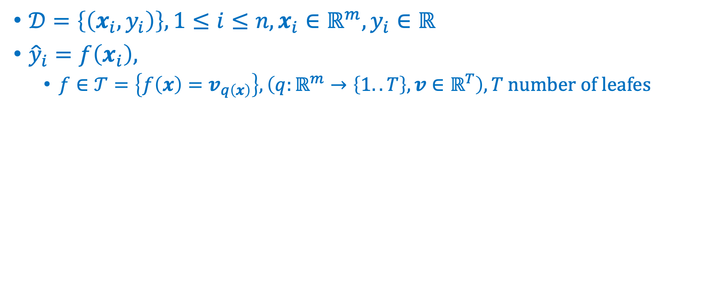
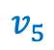
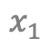
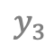

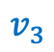
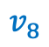
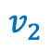
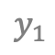
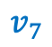
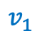
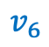
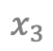
Trees
Markus Müller
$𝒟=\left\{\left(x_{i},y_{i}\right)\right\}, 1≤i≤n, x_{i}∈ℝ^{m},y_{i}∈ℝ$
${\hat{y}}_{i}=f\left(x_{i}\right),$
$f∈𝒯=\left\{f\left(x\right)=v_{q\left(x\right)}\right\}, \left(q:ℝ^{m}→\left\{1..T\right\}, v∈ℝ^{T}\right), T \text{number} \text{of} \text{leafes}$
$$v_{4}$$
$$y_{4}$$
$$v_{1}$$
$$y_{3}$$
$$v_{7}$$
$$v_{5}$$
depth
$$y_{2}$$
$$v_{2}$$
$$v_{3}$$
$$y_{1}$$
$$v_{8}$$
$$v_{6}$$
$$x_{1}$$
$$x_{2}$$
$$x_{3}$$
Leave nodes

Slide 2
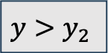
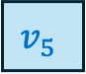
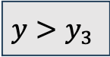
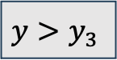
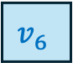
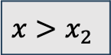
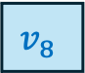
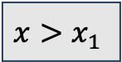
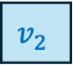
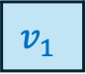
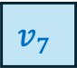
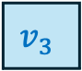
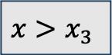
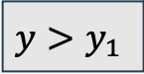
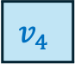
$$x>x_{2}$$
$$x>x_{1}$$
$$y>y_{3}$$
$$y>y_{1}$$
$$y>y_{2}$$
$$x>x_{3}$$
$$v_{1}$$
$$v_{8}$$
$$v_{7}$$
$$v_{6}$$
$$y>y_{3}$$
$$v_{2}$$
$$v_{3}$$
$$v_{4}$$
$$v_{5}$$

Slide 3
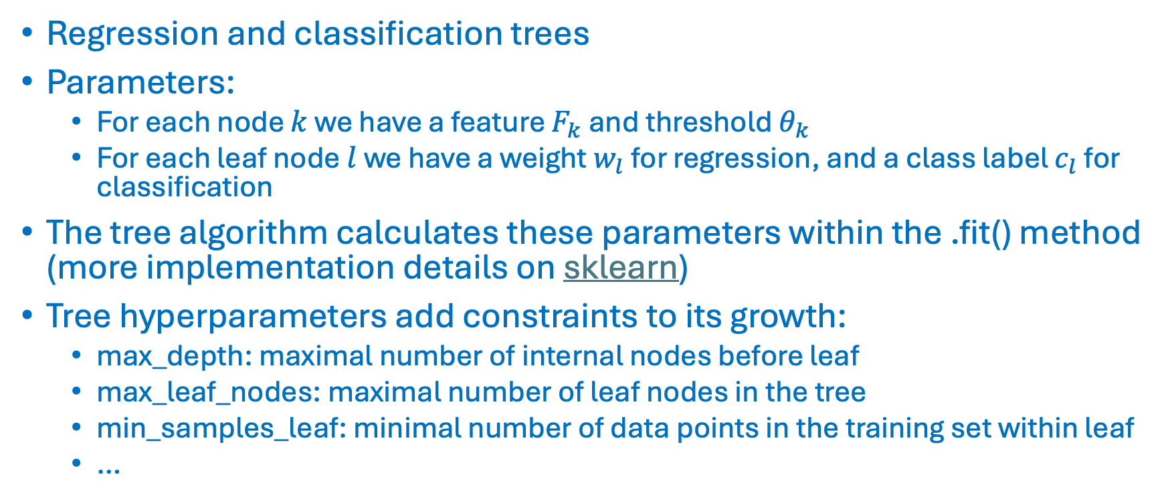
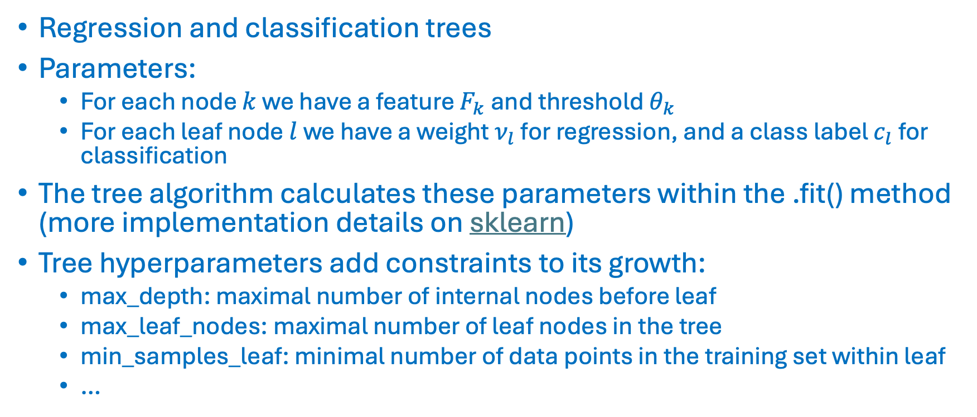
Trees
Markus Müller
Regression and classification trees
Parameters:
For each node $k$ we have a feature $F_{k}$ and threshold $θ_{k}$
For each leaf node $l$ we have a weight $ν_{l}$ for regression, and a class label $c_{l}$ for classification
The tree algorithm calculates these parameters within the .fit() method (more implementation details on sklearn)
Tree hyperparameters add constraints to its growth:
max_depth: maximal number of internal nodes before leaf
max_leaf_nodes: maximal number of leaf nodes in the tree
min_samples_leaf: minimal number of data points in the training set within leaf
…

Slide 4
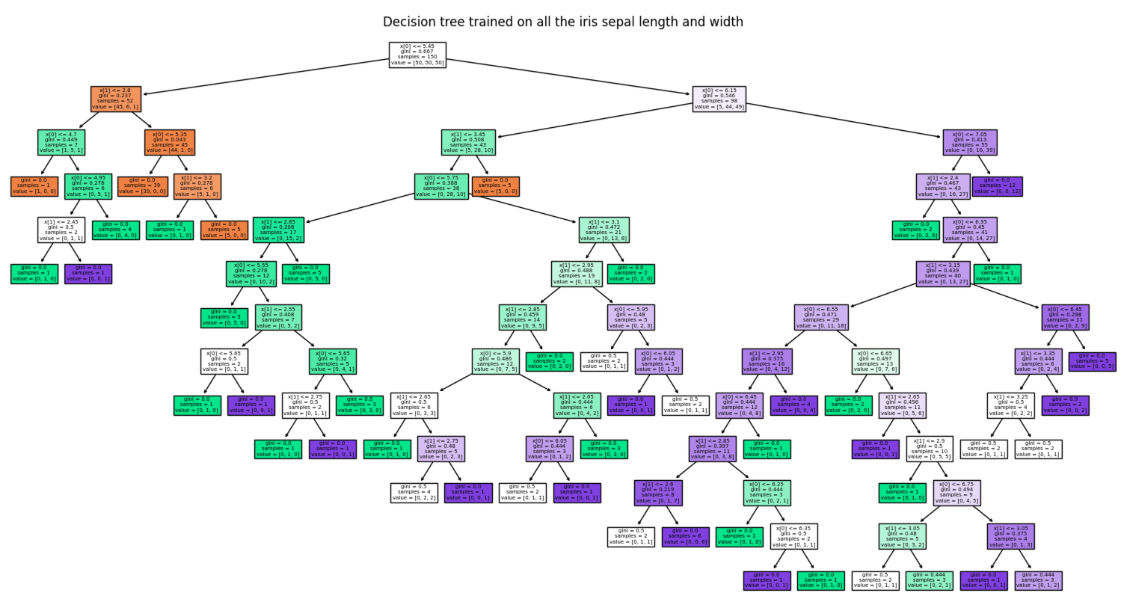
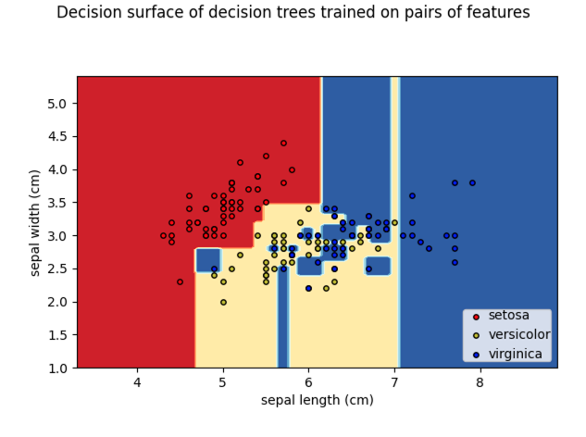
Trees
Markus Müller
Code on sklearn page !

Slide 5
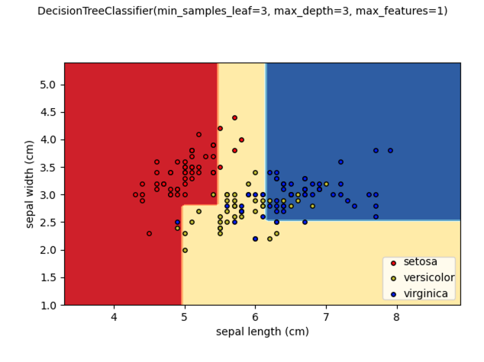
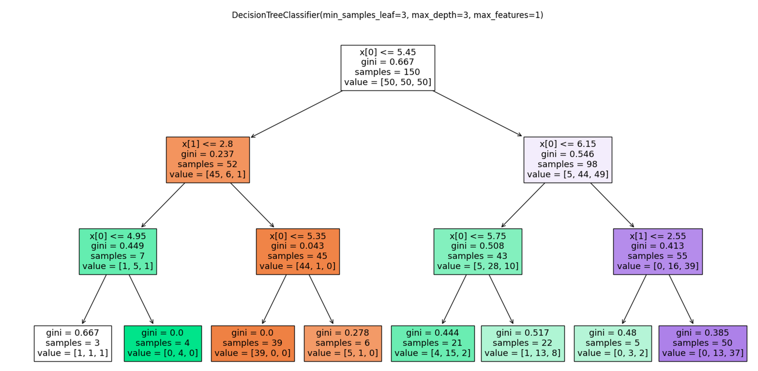
Tree hyperparamters
Markus Müller

Slide 6
Bagging and Boosting
Markus Müller
Obtain a good classifier by combining many basic, weak classifiers
Classifiers have two types of errors:
Bias (e.g. linear classifiers)
Variance (e.g. kNN, trees, unstable classifiers)
Weak classifiers are for example linear classifiers (high bias for non-linear problems) or tree classifiers (high variance without pruning)
Weak classifiers have either a high bias and/or high variance
Weak classifiers have to be better than random labels

Slide 7
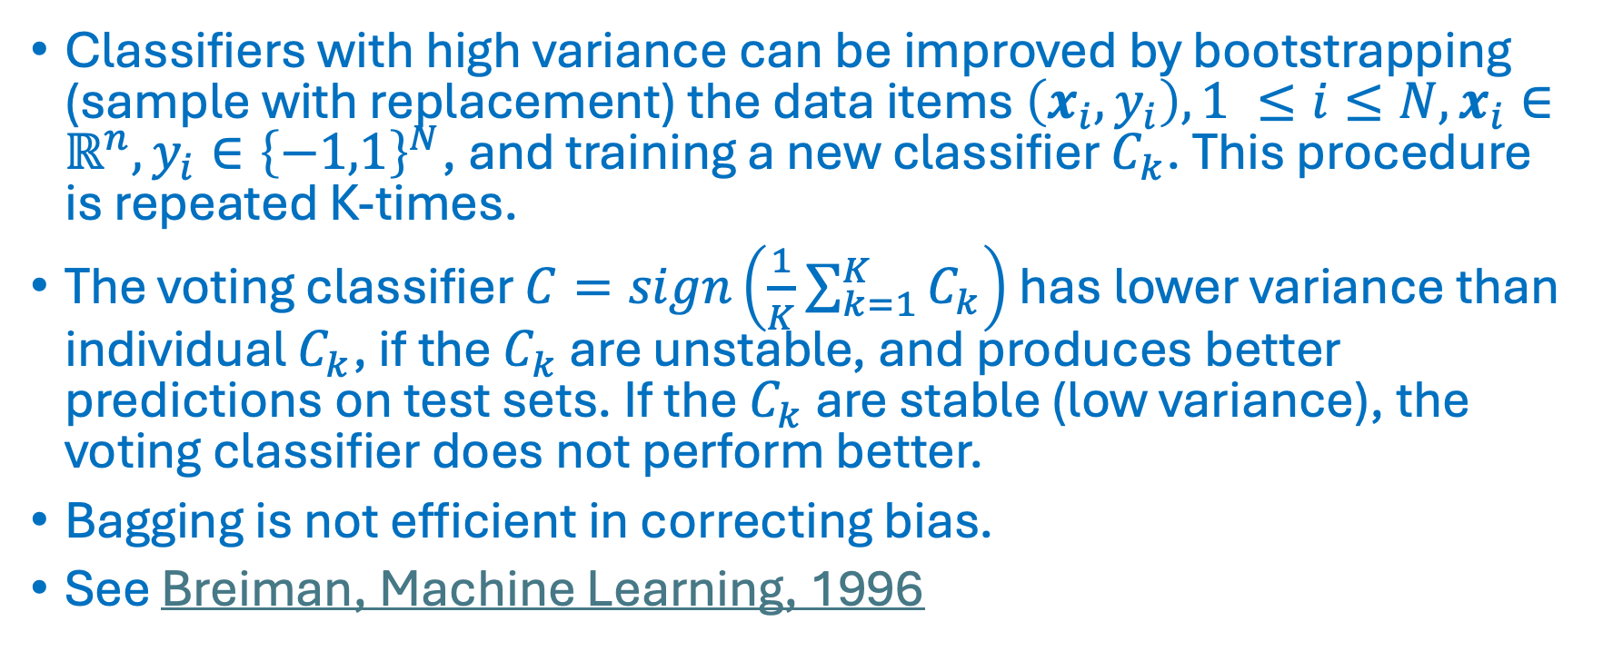
Bagging
Markus Müller
Classifiers with high variance can be improved by bootstrapping (sample with replacement) the data items $\left(x_{i},y_{i}\right), 1 ≤i≤N, x_{i}∈ℝ^{n}, y_{i}∈{\left\{−1,1\right\}}^{N}$, and training a new classifier $C_{k}$. This procedure is repeated K-times.
The voting classifier $C=sign\left(\frac{1}{K}\sum_{k=1}^{K}{C_{k}}\right)$ has lower variance than individual $C_{k}$, if the $C_{k}$ are unstable, and produces better predictions on test sets. If the $C_{k}$ are stable (low variance), the voting classifier does not perform better.
Bagging is not efficient in correcting bias.
See Breiman, Machine Learning, 1996

Slide 8
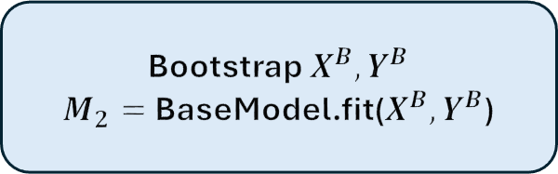
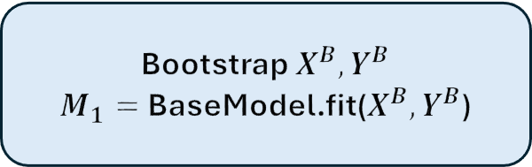
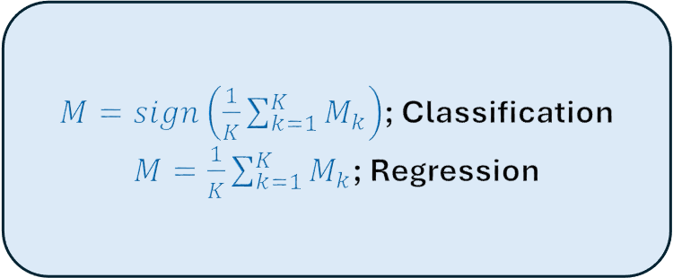
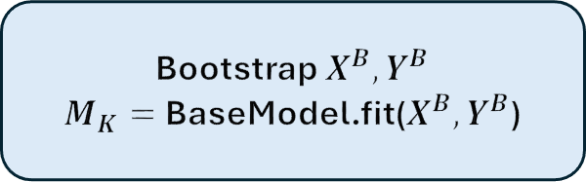
Bagging
Markus Müller
Bootstrap $X^{B},Y^{B}$
$M_{1}=$BaseModel.fit($X^{B},Y^{B}$)
$M=sign\left(\frac{1}{K}\sum_{k=1}^{K}{M_{k}}\right)$; Classification
$M=\frac{1}{K}\sum_{k=1}^{K}{M_{k}}$; Regression
Bootstrap $X^{B},Y^{B}$
$M_{2}=$BaseModel.fit($X^{B},Y^{B}$)
Bootstrap $X^{B},Y^{B}$
$M_{K}=$BaseModel.fit($X^{B},Y^{B}$)

Slide 9
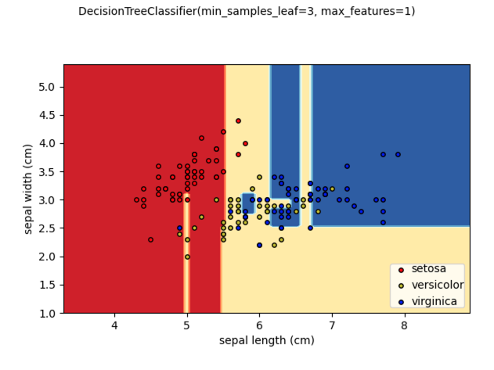
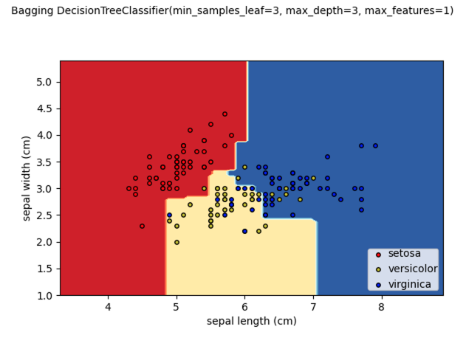
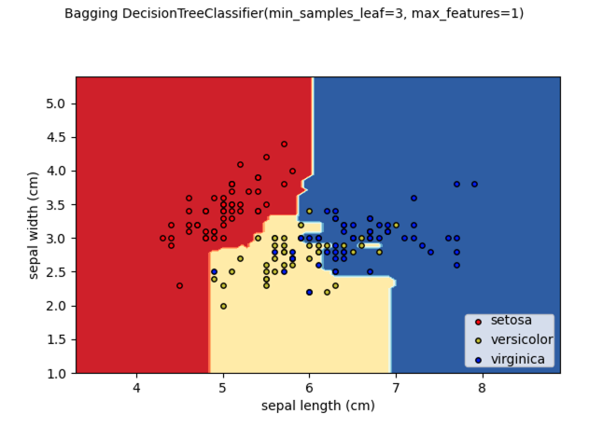
Bagging
Markus Müller
K = 1
K = 100

Slide 10
Random Forest
Markus Müller
Bootstrapped samples in bagging are similar and produce correlated base model outputs, which decreases the efficiency of bagging.
Random Forest is a bagging approach where both data items and features are sampled in order to de-correlate the trees.
A predefined number of features is sampled at each decision node in the tree. The splits in that node can only involve the selected features.
Base trees can be pruned with the max_depth, max_leaf_nodes, min_samples_leaf, … hyperparameters
Breiman, Machine Learning, 2001

Slide 11
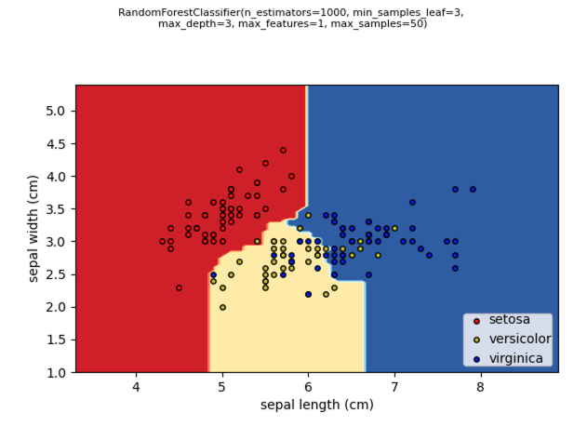
Random Forest
Markus Müller
RandomForestClassifier on sklearn

Slide 12
Boosting
Markus Müller
Bagging algorithms and RF can decrease the variance, but they cannot efficiently correct the bias of a weak classifier.
The AdaBoost algorithm (Freund & Shapire, ICML, 1996) corrects the bias too, and offers a very powerful method, which works well for many data types.
In each iteration, boosting tries to correct the error of the previous iteration by increasing the weights of the misclassified data items.
The current classifier focuses on those misclassified data points and is added to the previous classifiers.

Slide 13
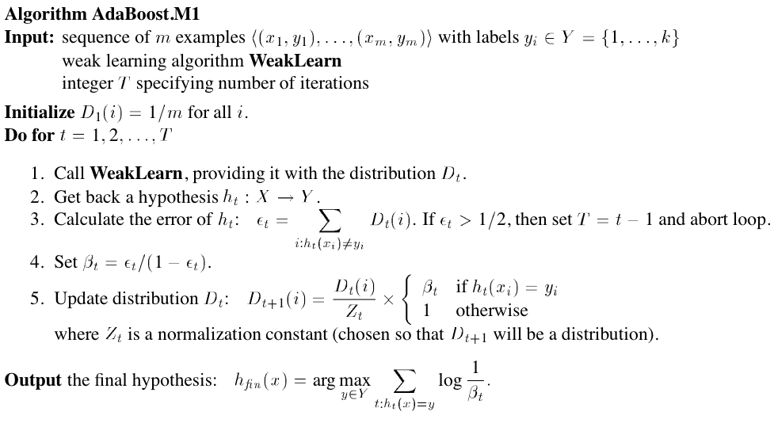
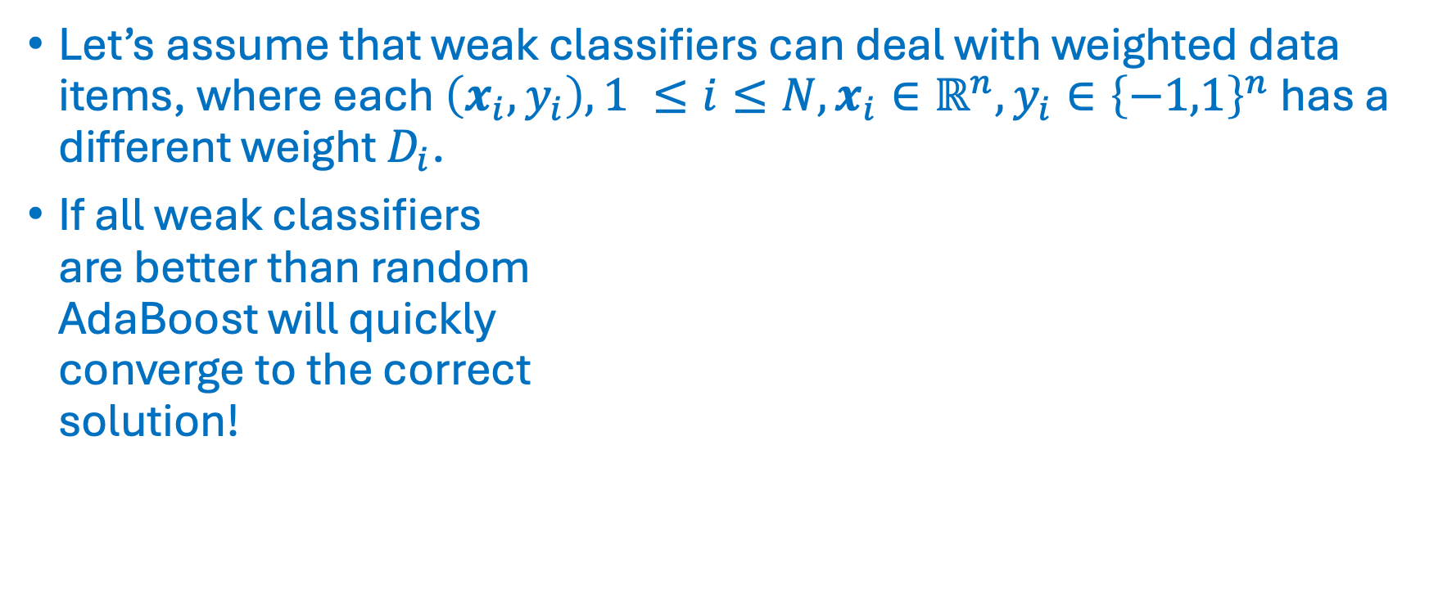
AdaBoost
Markus Müller
Let’s assume that weak classifiers can deal with weighted data items, where each $\left(x_{i},y_{i}\right), 1 ≤i≤N, x_{i}∈ℝ^{n}, y_{i}∈{\left\{−1,1\right\}}^{n}$ has a different weight $D_{i}$.
If all weak classifiers are better than random AdaBoost will quickly converge to the correct solution!
Notes:
AdaBoost.M1 for base classifier that outputs one class label
AdaBoost.M2 for base classifier that outputs class probabilities

Slide 14
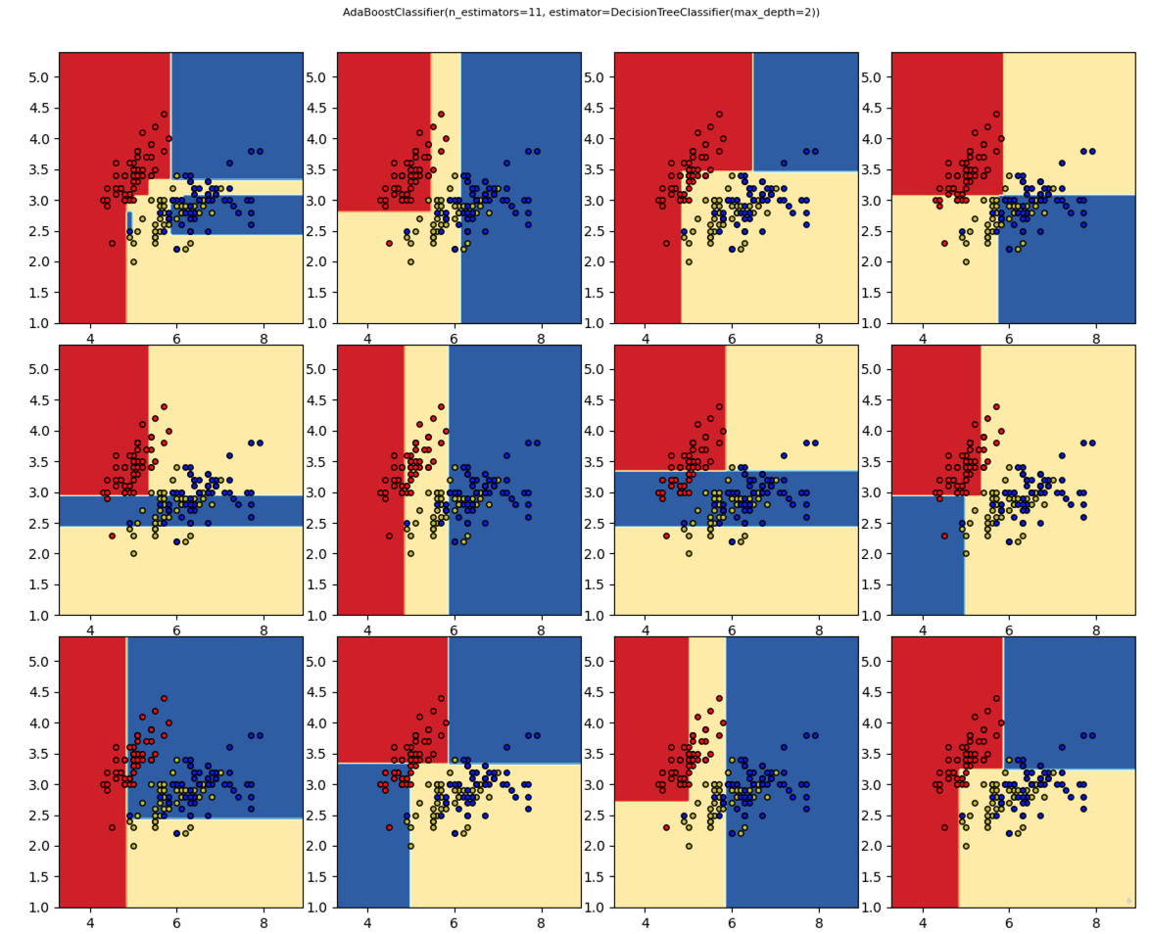
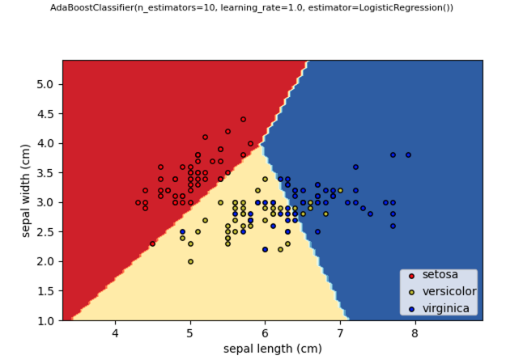
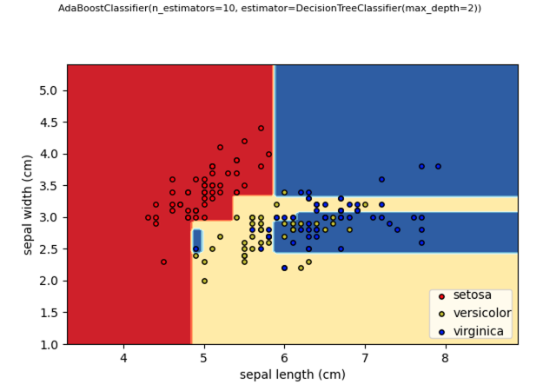
AdaBoost
Markus Müller

Slide 15
Gradient Boosting
Markus Müller
Mason et al. (Mason et al., NIPS, 1999) showed that AdaBoost is a special case of the Gradient Boosting framework.
In the gradient boosting framework, you choose a cost function and select a weak classifier, which minimizes the gradient of the cost function (in function space)
Mason et al. showed that some cost functions can perform better than AdaBoost, which is more prone to overfitting.
For a thorough comparison of bagging and boosting methods see Dietterich, Machine Learning, 2000.

Slide 16
XGBoost: a scalable and flexible gradient boosting system
Markus Müller
Introduced by Chen & Guestrin in 2016 (Chen & Guestrin, KDD 16, 2016)
Efficient and configurable implementation for tree and linear boosting for regression, classification and ranking.
Support for parallelization, cluster computing and GPU.
User can choose cost function and contraints on trees.
XGBoost provides more robust and complementary results compared to neural network models on tabular data (KDDCup 2015, Shwartz-Ziv & Armon, arXiv, 2021)

Slide 17
XGBoost
Markus Müller
Exact greedy (slower) and approximate (faster) algorithms
Deal with missing values (sparsity aware)
Include feature interaction constraints
Include monotonicity constraints
Include regularization (shrinkage, sampling, penalties)
Callbacks, early stopping
Parallel on multiple CPUs, support for Spark distributed computing
GPU support
Out-of-core computing (data larger than memory)
Since 2.0: optimize histo size, learning to rank, quantile regression, federated learning

Slide 18

XGBoost (for tree base classifiers)
Markus Müller
${\hat{y}}_{i}=φ\left(x_{i}\right)=\sum_{k=1}^{K}{f_{k}\left(x_{i}\right); f_{k}\left(x_{i}\right)=}$ base tree classifier
$ℒ\left(φ\right)=\sum_{i=1}^{N}{l\left({\hat{y}}_{i},y_{i}\right)+}\sum_{k=1}^{K}{Ω\left(f_{k}\right)}$ : regularized learning objective
loss function $l\left({\hat{y}}_{i},y_{i}\right)$ (e.g. square loss $l\left({\hat{y}}_{i},y_{i}\right)={\left({\hat{y}}_{i}−y_{i}\right)}^{2}$)
regularization term $Ω\left(f\right)=γT+\frac{1}{2}λ\left\|v^{2}\right\|$
$T$: number of leaves; $v$: values at leaf
But searching over all combinations of trees is too slow

Slide 19

XGBoost
Markus Müller
Boosting: fit tree to error $y_{i}−{\hat{y}}_{i}^{t−1}$of previous iteration
$ℒ^{t}\left(φ\right)=\sum_{i=1}^{N}{l\left(y_{i},{\hat{y}}_{i}^{t−1}+f_{t}\left(x_{i}\right)\right)+}Ω\left(f_{t}\right)$
Gradient boosting:
$ℒ^{t}\left(φ\right)≈\sum_{i=1}^{N}{l\left(y_{i},{\hat{y}}_{i}^{t−1}\right)+g_{i}f_{t}\left(x_{i}\right)+\frac{1}{2}h_{i}f_{t}^{2}\left(x_{i}\right)+}Ω\left(f_{t}\right)=\sum_{i=1}^{N}{l\left(y_{i},{\hat{y}}_{i}^{t−1}\right)+}{\tilde{ℒ}}^{t}\left(q\right)$
$g_{i}=\frac{∂}{∂{\hat{y}}_{i}^{t−1}}l\left(y_{i},{\hat{y}}_{i}^{t−1}\right)$; $h_{i}=\frac{∂^{2}}{∂^{2}{\hat{y}}_{i}^{t−1}}l\left(y_{i},{\hat{y}}_{i}^{t−1}\right)$

Slide 20


XGBoost
Markus Müller
Example: square loss $l\left(x\right)=x^{2}$
Gradient boosting:
${\tilde{ℒ}}^{t}\left(q\right)=\sum_{i=1}^{N}{2\left({\hat{y}}_{i}^{t−1}−y_{i}\right) f_{t}\left(x_{i}\right)+ f_{t}^{2}\left(x_{i}\right)+Ω\left(f_{t}\right)}$
$$\begin{matrix}\left({\hat{y}}_{i}^{t−1}−y_{i}\right)>0:f_{t}\left(x_{i}\right)<0 \\ \left({\hat{y}}_{i}^{t−1}−y_{i}\right) \sim 0:f_{t}\left(x_{i}\right) \sim 0 \\ \left({\hat{y}}_{i}^{t−1}−y_{i}\right)<0:f_{t}\left(x_{i}\right)>0\end{matrix}$$
Regularization term

Slide 21

XGBoost
Markus Müller
Initialize $f_{0}\left(x\right)=\underset{v,q}{argmin}{ℒ\left(f\right)}$
$\text{for} k=1..K$
Sample columns of $X$ and/or rows of $X, y$
$f_{k}\left(x\right)=\underset{v,q}{argmin}{{\tilde{ℒ}}^{t}\left(v,q\right)}$ (see below)
$φ_{k}\left(x_{i}\right)=$ $φ_{k−1}\left(x_{i}\right)+η$ $f_{k}\left(x\right)$, shrinkage parameter eta $0<η≤1$
Output $φ_{K}\left(x_{i}\right)$

Slide 22

XGBoost
Markus Müller
Assume $f_{t}$ is fixed appart from the leaf values $v$
Define $I_{j}=\left\{i | q\left(x_{i}\right)=j\right\}$, i.e. all points $x_{i}$ belonging to leaf $j$
Then the optimal leaf values are:
$v_{j}=−\frac{\sum_{i∈I_{j}}{g_{i}}}{\sum_{i∈I_{j}}{h_{i}+λ}}$
${\tilde{ℒ}}^{t}\left(q\right)=−\frac{1}{2}\sum_{j=1}^{T}{\frac{{\left(\sum_{i∈I_{j}}{g_{i}}\right)}^{2}}{\sum_{i∈I_{j}}{h_{i}+λ}}}+λT$
Finding $q$ that minimizes ${\tilde{ℒ}}^{t}\left(q\right)$ is difficult. A greedy algorithm finds the split $I=I_{L}⋃$ $I_{R}$ that maximizes $ℒ_{split}=\frac{1}{2}\left[\frac{{\left(\sum_{i∈I_{L}}{g_{i}}\right)}^{2}}{\sum_{i∈I_{L}}{h_{i}+λ}}+\frac{{\left(\sum_{i∈I_{R}}{g_{i}}\right)}^{2}}{\sum_{i∈R}{h_{i}+λ}}−\frac{{\left(\sum_{i∈I_{ }}{g_{i}}\right)}^{2}}{\sum_{i∈I_{ }}{h_{i}+λ}}\right]$

Slide 23

XGBoost
Markus Müller
Notes:
Exact algo

Slide 24
XGBoost Hyperparameters
Markus Müller

Slide 25

XGBoost
Markus Müller

Slide 26

XGBoost +/-
Markus Müller
When to use XGBoost
Classification problems
Categorical variables
Missing values
Tabular data with heterogeneous features
When not to use XGBoost
$n>N$, i.e. more features than observations
Regression tasks, where output needs to be continuous
Extrapolation tasks
For image and language processing NN are preferred
Other excellent gradient boosting tools are LightGBM, CatBoost,..
Notes:
LightGBM: Microsoft
CatBoost: Yandex

Slide 27

Hyperparameters
Markus Müller
In the classification task, we would like to predict the outcome $y$ from the features $X$.
We choose a classifier $𝒞_{φ}$ with hyper parameters $φ$ and internal parameters $θ$.
Hyper parameters (e.g $k$ in $k−NN$, kernel in $SVM$, learning rate in $LR$) have to be specified by the user or learned in CV loop outside the classifier.
The internal parameters $θ$ are learned by the classifier (e.g. the coefficients in $LR$, or support vector coefficients in $SVM$).
The classifier learns those internal parameters $θ$ that are able to predict $y$ from the features $X$ with the lowest error: $θ=\underset{θ}{argmin}{ℒ\left(𝒞_{φ}.\text{predict}\left(X,θ\right),y\right)}$ where the loss function $ℒ$ measures the error between predicted ($𝒞_{φ}.\text{predict}\left(X,θ\right)$) and known ($y$) outcomes.

Slide 28
Hyperparameter optimization
Markus Müller
ML models have internal parameters, which are learned by the training algorithm, and hyperparameters, which have to be set before training.
Both internal - and hyperparameters have a strong impact on the performance of the ML model.
There is a tradeoff between CPU/GPU cycles spent on hyperparameter optimization and training. Allocating more cycles for hyperparameter optimization can be more rewarding.
Hyperparameter optimization is implemented as an outer loop over the CV loop

Slide 29

Hyperparameter optimization and CV
Markus Müller
Hyperparameter space $Φ$
Dataset $X$, Labels $y$
Number of iterations $M$
Number of CV folds $F$
$S_{max}=−∞$, $φ_{max}=None$
for $i=1,..,M$ :
$$φ=choose\left(Φ\right)$$
for $j=1,..,F$ :
$X_{train},$ $X_{test},y_{train}, y_{test}=split\left(X,j\right)$
${C_{φ,θ}=𝒞}_{φ}$.train$\left(X_{train}\right)$
$S_{j}=S\left(C_{φ,θ}.\text{predict}\left(X_{test}\right),y_{test}\right)$
$\overline{S}=\frac{1}{F}\sum_{j=1}^{F}{S_{j}}$
if $\overline{S}>S_{max}$: $S_{max}=\overline{S}$, $φ_{max}=$ $φ$
Hyperparameter loop
CV loop

Slide 30
Hyperparameter optimization
Markus Müller
Hyperparameters have grid or tree-structured configuration spaces of discrete, ordinal, and continuous variables.
Complete tree or grid searches are often too slow for large search spaces:
Random searches
Clever algorithms that suggest which parameter combination to test in the next step based on previous results.
Hyperopt (Bergstra et al. Neurips 2011) implements both strategies. It is open-source and available on https://github.com/hyperopt/hyperopt.
Other tools are Hypermax (tree parzen estimator), Scikit-Optimizer (skopt) (Bayesian), Spearmint (Bayesian), Hyperband (fast random armed bandit), Optuna (dynamic search space, pruning, easy API), …

Slide 31
Hyperopt
Markus Müller
Random algorithms find optimal solutions faster and more accurately than grid searches (Bergstra & Bengio, J. Mach. Learn. Res., 2012)
Therefore Hyperopt implements a random search algorithm.
Hyperopt also offers two other model-based search algorithms:
Gaussian process approach (GP)
Tree-structured Parzen window approach (TPE)

Slide 32


Hyperopt’s model-based algorithm
Markus Müller
$$S\left(x, M\right)={EI}_{y^{∗}}\left(x\right)=\int_{−∞}^{+∞}{\max_{ }\left(y^{∗}−y,0\right)p_{M}\left(y | x\right)dy}$$
$$EI: \text{Expected} \text{improvement} \text{for} \text{score} \text{values} x$$

Slide 33





Hyperopt’s GP algorithm
Markus Müller
$$S\left(x, M\right)={EI}_{y^{∗}}\left(x\right)=\int_{−∞}^{+∞}{\max_{ }\left(y^{∗}−y,0\right)p_{M}\left(y | x\right)dy};y^{∗}=\min_{ }\left\{f\left(x_{i}\right), 1≤i≤n\right\}$$
$p_{M}\left(y | x\right)$: estimated by gaussian process (GP)
The GP algorithms will give a large EI value for hyperscore
values $x$ if a large probability mass is below $y^{∗}$. This is the
case for
values of $x$ close to the minimum
values of $x$ in not yet explored regions, which have a large uncertainty
$$y^{∗}$$

Slide 34










Hyperopt’s TPE algorithm
Markus Müller
$$S\left(x, M\right)={EI}_{y^{∗}}\left(x\right)=\int_{−∞}^{+∞}{\max_{ }\left(y^{∗}−y,0\right)p_{M}\left(y | x\right)dy}=\int_{−∞}^{y^{∗}}{\underset{ }{\left(y^{∗}−y\right)}\frac{p_{M}\left(x | y\right)p\left(y\right)}{p\left(x\right)}{dy}}$$
$∝{\left(γ+\frac{g\left(x\right)}{l\left(x\right)}\left(1−γ\right)\right)}^{−1}$
$$y^{∗}=γ−\text{quantile}:p\left(y<y^{∗}\right)=γ$$
$$p_{M}\left(x | y\right)=\left\{\begin{aligned}l\left(x\right) \text{if} y≤y^{∗} \\ g\left(x\right) \text{if} y>y^{∗}\end{aligned}\right.$$
g$\left(x\right)$
The TPE algorithm will give a large EI value for hyperscore
values $x=\underset{x}{argmax}{{g\left(x\right)}/{l\left(x\right)}}, i.e.$it will choose hyperscores with large $l\left(x\right)$ and small $g\left(x\right)$.
$$y^{∗}$$
$$l\left(x\right)$$
TPE: Tree structured Parzen estimator

Slide 35

Hyperopt Iterations
Markus Müller
Müller et al. Immunity, 2024

Slide 36

Nested Cross-Validation (CV)
Markus Müller
Issues that may arise with CV:
Let’s assume you perform a hyperparameter optimization for a classifier with CV. In each iteration, you keep the maximal score $S_{max}$. Even if all scores are drawn from Null distribution, this will lead to a final score $S_{max}$that is significantly higher than the expected score.
We strongly discourage ML practitioners to perform any operation that uses information from test or validation data (such as feature selection, MV imputation, normalization) for data preprocessing pefore the CV loop. In the CV loop, this data leakage will lead to $S_{max}$ that are too high, especially for small sample sizes.
Solution: always calculate your score $S$ on a part of the data that was not used for proprocessing.

Slide 37

Nested Cross-Validation (CV)
Markus Müller
Valabas et al. PLoS, 2019

Slide 38


Nested Cross-Validation (CV)
Markus Müller
Simple CV
Nested CV
Varma & Simon, BMC Bioinformatics, 2006

Slide 39


Nested Cross-Validation (CV)
Markus Müller
Valabas et al. PLoS, 2019

Slide 40
Interpretable Machine Learning (IML)
Markus Müller
ML tools are optimized for metrics such as accuracy, which can lead to accurate, but wrong models.
Many models are black boxes, i.e. they do not reveal in a human readable form how they make their decision.
In order to understand a model, we need to approximate the model’s decision with a simple human readable model.
If this simple approximation corresponds to human intuition and is faithful (i.e. truly reflects the underlying ML model), we can better trust the ML model.

Slide 41


Interpretable Machine Learning (IML)
Markus Müller
Ribeiro et al., ACM SIGKDD, 2016

Slide 42
Interpretable Machine Learning (IML)
Markus Müller
What does «interpretable» mean in the context of ML?
A good IML model has to deliver an interpretation of an ML model prediction that is human-readable, plausible, and faithful.
Plausible: how convincing is the interpretation to humans
Faithful:
the IML interpretation approximates the true reasoning process of the ML model
the interpretation should not change drastically if different datasets are used for the ML model training or prediction.
it should be similar for different ML models, which make similar predictions.
https://christophm.github.io/interpretable-ml-book/
Chen et al, Nature Methods, 2024

Slide 43
Interpretable Machine Learning (IML)
Markus Müller
Some ML methods such as linear regression, logistic regression, decision trees, GLM’s, GAM’s are interpretable by humans, i.e. they tell you explicitly how features contribute to the outcome.
Other ML methods (such as NN, SVM, and boosting methods) can perform very well but are not interpretable by humans.
However, understanding prediction by ML model is important to trust the model, study biases, and eventually improve it.
Either, these black-box methods are customized for interpretability or one has to use post hoc tools such as Shap, Lime, DeepLIFT, ...
These ad-hoc tools provide human interpretable simple models, which approximate the underlying complex ML model.
Such simple models may be feature importance scores (linear approximation), simple trees, or decision rules.

Slide 44

Interpretable Machine Learning (IML)
Markus Müller
Chen et al, Nature Methods, 2024

Slide 45
Interpretable Machine Learning (IML)
Markus Müller
However, there is no consensus, which IML method works best (Krishna et al, Mach. Learning Research, 2024; Agarwal et al. NeurIPS, 2022)
Need to evaluate the IML interpretation scores by these criteria:
Plausibility: is the interpretation plausible? Do the IML interpretations agree with prior knowledge?
Faithfulness: Does it give the correct answers on synthetic datasets (https://open-xai.github.io/)? Do they reflect the model’s reasoning process?
Stability: are the scores robust for different hyperparameter choices for the underlying model? Are they robust with regard to data sampling and different datasets? Do different IML methods give similar results?

Slide 46
IML Guidelines
Markus Müller
Use several IML methods and compare the results
Use several datasets if possible, or randomly sample from your data, to show that your results are robust.
Use different hyperparameter choices for the underlying model. Use more than one model.
Evaluate the plausibility and faithfulness of the IML interpretation:
Do they agree with prior or expert knowledge?
Do they represent the model’s reasoning process?
Avoid cherry-picking nice examples, but always report full results.
Chen et al, Nature Methods, 2024

Slide 47

IML
Markus Müller
Local interpretation:
An interpretation is calculated for a single data vector $x$.
A local interpretation tells you, how a specific data vector $x$ was predicted by the ML model. It tells you which features are predominantly involved in the prediction.
Global interpretation:
An interpretation is calculated on a whole data set $\left\{x_{k}\right\}, k=1,..,N$
The global interpretation tells you, which features are predominantly involved in the prediction of a whole dataset.
A global interpretation can be obtained by averaging over local interpretations.

Slide 48
LIME
Markus Müller
LIME: Local Interpretable Model-Agnostic Explanations
Approximates any ML model by a simple local model
Provides control over the complexity of the local model
Provides global interpretation of the ML model
https://github.com/marcotcr/lime
Watch: https://www.youtube.com/watch?v=hUnRCxnydCc
Ribeiro et al., ACM SIGKDD, 2016

Slide 49

LIME
Markus Müller
Let’s assume we have a trained ML model, which predicts the output $f\left(x\right)$ of a vector $x=\left(x_{1},..,x_{n}\right)∈ℝ^{n}$
Let $x′∈{\left\{0,1\right\}}^{n^{′}}$be an interpretable representation of $x$
For a feature vector $x∈ℝ^{n}$, $x^{′}=\left(0,0,1,…,1, 0\right)$ $∈{\left\{0,1\right\}}^{n}$ means features with a 1 (0) are included (excluded)
For a text input, $x^{′}=\left(0,0,1,…,1, 0\right)$ $∈{\left\{0,1\right\}}^{n^{′}}$ means that the first two words in a dictionary are absent in the text, the third one is present, …
For an image input $x∈ℝ^{n}$, $x^{′}=\left(0,0,1,…,1, 0\right)$ $∈{\left\{0,1\right\}}^{n^{′}}$may indicate the presence/absence of a continuous image region with similar pixel properties (super-pixel)

Slide 50





LIME
Markus Müller
Text
“The dog plays with another dog in the park.”
Feature vector
Image
Feature | $$x$$ | $$x^{′}$$
another | 1 | 1
car | 0 | 0
cat | 0 | 0
dog | 2 | 1
mouse | 0 | 0
park | 1 | 1
play | 1 | 1
Feature | $$x$$ | $$x^{′}$$
sneeze | yes | 1
weight | 60 | 0
headache | yes | 1
no fatigue | -1 | 1
age | 55 | 0
$$x=$$
$$x^{′}=\left(0,0,0,..,1,1,..0\right)$$

Slide 51

LIME
Markus Müller
Let $g∈G$ be our simple approximation model of a certain class $G$ (linear model, Tree, ..).
$g:x′⟼g\left(x′\right)∈ℝ$. E.g. $g\left(x′\right)=$ $w_{g}∙$ $x′$
$Ω\left(g\right)$: enforces contraint on complexity of $g$. E.g. $Ω\left(g\right):{\left\|w_{g}\right\|}_{0}≤K$ for linear $g$, or $depth\left(g\right)$ $≤K$ for a tree.
$π_{x}\left(z\right)$: distance measure between input vectors $x$and $z$. E.g. $π_{x}\left(z\right)=exp\left({−D\left(x,z\right)}/{σ^{2}}\right)$
Masking: $z\left(x, bg,x^{′}\right)≡\left\{\begin{matrix}x_{i} \text{for} {x′}_{i}=1 \\ {bg}_{i} \text{for} {x′}_{i}=0\end{matrix}\right.$
$ℒ\left(f,g,π_{x}\right)$: measure how faithful $g$ approximates $f$. E.g. $ℒ\left(f,g,π_{x}\right)=\sum_{z,z^{′}∈𝓩}{π_{x}\left(z\right)}{\left(f\left(z\right)−g\left(z′\right)\right)}^{2}$

Slide 52


LIME: local interpretation
Markus Müller
$$ξ\left(x\right)=\underset{g∈G}{argmin}{ℒ\left(f,g,π_{x}\right)+Ω\left(g\right)}$$

Slide 53

LIME : local interpretation
Markus Müller

Slide 54


LIME : global interpretation
Markus Müller

Slide 55

Shapley Values
Markus Müller
Developed by economics Noble prize winner Loyd Shapley in 1951 (Shapley )
How do you evaluate the importance of a single player in a team of $n$ players $𝒩$?
Let’s assume the outcome of the game is measured by a score $f$. E.g. $f$ might be the percentage of games won, or the probability of a classifier.
If only a subset $S⊂𝒩$of all players takes part in the game, the score is $f\left(S\right)$
Idea: the importance of a player is evaluated relative to all subsets of players $S$.

Slide 56





Shapley Values
Markus Müller
The Shapley value $φ_{i}$ of player $i$ is defined by: $φ_{i}\left(f\right)=\sum_{S⊂𝒩/{\left\{i\right\}}}{\frac{\left|S\right|!\left(n−\left|S\right|−1\right)!}{n!}}\left(f\left(S∪\left\{i\right\}\right)−f\left(S\right)\right)$
W$eight of S$
Gain in $v$ by including player $i$ in $S$
Sum over all subsets $S$

Slide 57

Shapley Values
Markus Müller
Shapley values have several desirable properties.
Efficiency: $\sum_{i∈𝒩}{φ_{i}\left(f\right)}=φ\left(𝒩\right)$
Monotonicity: $f\left(S∪\left\{i\right\}\right)−f\left(S\right)≥f′\left(S∪\left\{i\right\}\right)−f′\left(S\right) ∀S⊂$ $𝒩⇒ φ_{i}\left(f\right)≥φ_{i}\left(f′\right)$
Null player: If $f\left(S∪\left\{i\right\}\right)=f\left(S\right)$ $∀S⊂$ $𝒩$, $S∩\left\{i\right\}=∅$, then $φ_{i}\left(f\right)=0$
Symmetry: If $f\left(S∪\left\{i\right\}\right)=f\left(S∪\left\{j\right\}\right)$ $∀S⊂$ $𝒩$, $S∩\left\{i,j\right\}=∅$, then $φ_{i}\left(f\right)=φ_{j}\left(f\right)$
Linearity: $φ_{i}\left(f+u\right)=φ_{i}\left(f\right)+φ_{i}\left(u\right)$
The Shapley formula is the only formula that has all these properties
There are extensions of Shapley values for feature groups and feature interactions.
BUT: how can we calculate the Shapley values efficiently for large $n$?

Slide 58

Shapley Values for ML
Markus Müller
Let’s assume we have a trained ML model, which predicts the output $f\left(x_{j}\right)$ of a vector $x_{j}=\left(x_{j1},..,x_{jn}\right)∈ℝ^{n}$ from our dataset $𝒟=\left\{x_{j}\right\},1≤j≤N$
$S⊂$ $𝒩=\left\{1,..,n\right\}$. How do we define $f\left(x,S∪\left\{i\right\}\right)−f\left(x,S\right)$?
Define mask: $x_{S}\left(x, y\right)≡\left\{\begin{matrix}x_{i} \text{for} i∈S \\ y_{i} \text{for} i∉S\end{matrix}\right.$
$$f\left(x,S\right)=E_{x_{𝒩\backslash S}}\left(f\left(x\right)\right)=\sum_{y∈𝒟}{\left[f\left(x_{S}\left(x, y\right)\right)−f\left(y\right)\right]}$$
$$φ_{i}\left(x\right)=\sum_{S⊂𝒩/{\left\{i\right\}}}{\frac{\left|S\right|!\left(n−\left|S\right|−1\right)!}{n!}}\left(f\left(x,S∪\left\{i\right\}\right)−f\left(x,S\right)\right)$$
$\sum_{i=1}^{n}{φ_{i}\left(x\right)}=f\left(x\right)−E_{x_{ }}\left(f\left(x\right)\right)$

Slide 59

Shapley Values for ML
Markus Müller
Shapley values are too time-consuming to calculate exactly for large $n$
Strumbelj & Kononenko, LNCS, 2011 provide a general sampling method
Lundberg et al., ICML, 2017 provide an efficient sampling method called Tree SHAP to calculate Shapley values for assemblies of trees (included in XGBoost)
Lundberg & Lee, NIPS, 2017 provide a unified view of LIME, DeepLIFT, and Shapley values. They also provide Kernel SHAP, a variant of LIME, which outputs Shapley values.
Python package SHAP (SHapley Additive exPlanations) available on github: https://github.com/slundberg/shap . It provides efficient calculation of Shapley values and many diagnostic plots.

Slide 60



IML with Shapley values
Markus Müller
Good prediction
Bad prediction
Müller et al. Immunity, 2024
Notes:
SHAP (SHapley Additive exPlanation) values explain the output of a function f as a sum of the effects φi of each
feature being introduced into a conditional expectation. Importantly, for non-linear functions the order in which features
are introduced matters. SHAP values result from averaging over all possible orderings. Proofs from game theory show this is
the only possible consistent approach where 􏰀M φi = f (x). In contrast, the only current individualized feature attribution i=0
method for trees satisfies the summation, but is inconsistent because it only considers a single ordering [24].
local accuracy, missingness, and consistency. Local accuracy states that the sum of the feature attributions is equal to the output of the function we are seeking to explain. Missingness states that features that are already missing (such that zi′ = 0) are attributed no importance. Consistency states that changing a model so a feature has a larger impact on the model will never decrease the attribution assigned to that feature.

